Slide 1
XL Spaceship
Assesment

Slide 2
Basic Information of game
The Project consists of two sub-projects.
  XL-server
  XL-client
XL-server is the backend part of the game which has rest end points to get request from frontend.
XL-client is the frontend part of the game and players(users) will directly interact with frontend.
There can be two players for every game.
Each player plays turn by turn.
One player requests for new game and system will randomly choose another player to play against the player.

Slide 3
XL-server
This is an independent project.
We used scala with akka-http to create rest endpoints.
There are 3 endpoints in the project
  Create new game
  Shoot the opponent
  Get current status of game

Slide 4
XL-server
Some commands for the project
Run project -> sbt run
Run Tests -> sbt run
Check ScalaStyle -> sbt scalastyle
Check Code Coverage -> sbt coverage test coverageReport
Current code coverage is > 80%
Create executable JAR-> sbt assembly
Run executable JAR -> java -jar <assembly jar>
Project is started on “localhost” port 8081, It can be changed in conf file in resources.

Slide 5
XL-client
XL-client is front end part of the game.
It has two pages
  Create game page
  Play game page
As the name suggests create game page is used to create a new game and play game is for playing the game.
When we create new game a link is generated to play the game.

Slide 6
XL-client cont...
The link has the pattern
  <host>:<port>/game/<player-id>/<game-id>
Game Id is created with the following pattern: “match-”<player-1-id>-<player-2-id>
The link will be for one player is
  localhost:3000/game/XL-101/match-XL-101-XL-102
For second player the link would be
  localhost:3000/game/XL-102/match-XL-101-XL-102

Slide 7
XL-client
XL-client is a node project.
We start express server to host the pages.
Commands for the project
Run the project -> npm start
The project is started on “localhost” port 3000

Slide 8
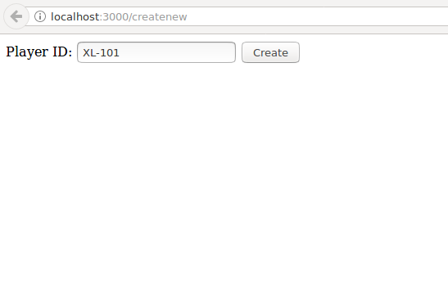
Create New Game
Write a player Id which are already in datastore
OR
If it is not there in the datastore then default player will be taken
And Another Random Player will be chosen as a opponent

Slide 9
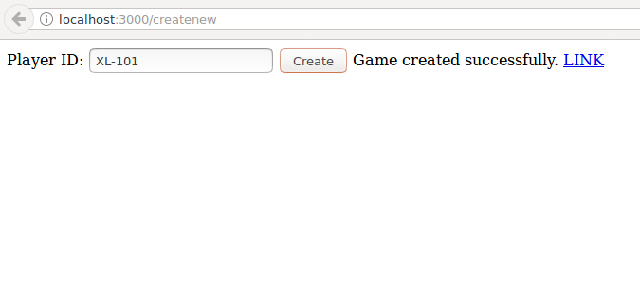
New Game Created
After successfully creation of game a link will be created for the game
Just click on the link to play.

Slide 10
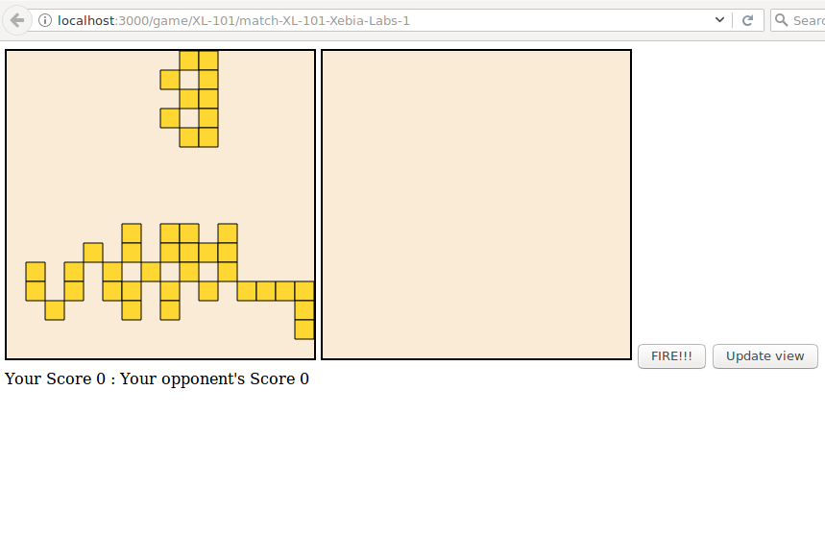
Players game page
This is how the page looks like.
Left board is player’s own board (The opponent will shoot on it)
Right board is opponent’s board. Player will choose co-ordinates
to shoot on opponent’s spaceshiip.
First player will choose the co-ordinates and then click the fire button.
Player can update the current status of the game
by clicking the “Update view” button.

Slide 11
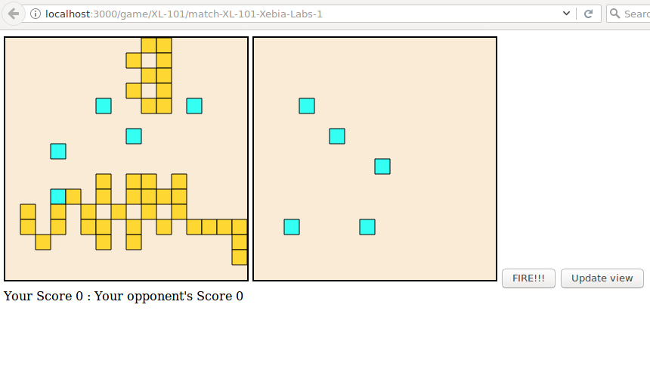
Selected co-ordinates to shoot
On left board, the blue pixels denotes that opponent
has shoot on these localtion.
On right board, the blue pixels denotes that
player(self) has chosen these locations to shoot.

Slide 12
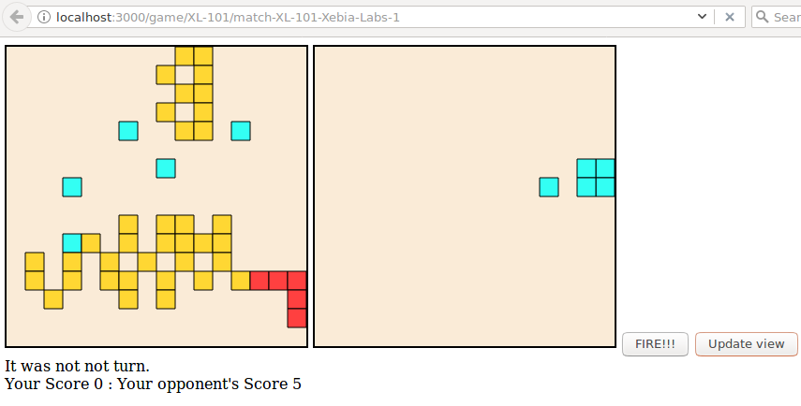
Spacecrafts are hit by bullets
If SpaceCraft is shot by opponent’s bullet then it would be denoted by Red.
If it is a miss then it would be denoted by Blue color.
Yellow dots are Spacecrafts.

Slide 13
Thank you

